Slide 1


Rimas Silkaitis
From Postgres to Cassandra

Slide 2


NoSQL vs SQL

Slide 3
||

Slide 4
&&

Slide 5

Rimas Silkaitis
Product
@neovintage

Slide 6


Slide 7

app cloud

Slide 8
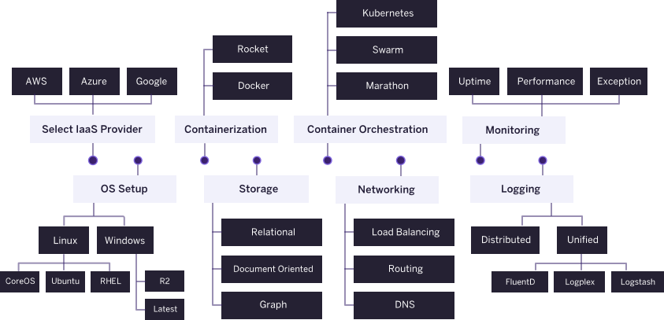

Slide 9

DEPLOY
MANAGE
SCALE

Slide 10
$ git push heroku master
Counting objects: 11, done.
Delta compression using up to 8 threads.
Compressing objects: 100% (10/10), done.
Writing objects: 100% (11/11), 22.29 KiB | 0 bytes/s, done.
Total 11 (delta 1), reused 0 (delta 0)
remote: Compressing source files... done.
remote: Building source:
remote:
remote: -----> Ruby app detected
remote: -----> Compiling Ruby
remote: -----> Using Ruby version: ruby-2.3.1

Slide 11

Heroku Postgres
Over 1 Million Active DBs

Slide 12

Heroku Redis
Over 100K Active Instances

Slide 13

Apache Kafka on Heroku

Slide 14
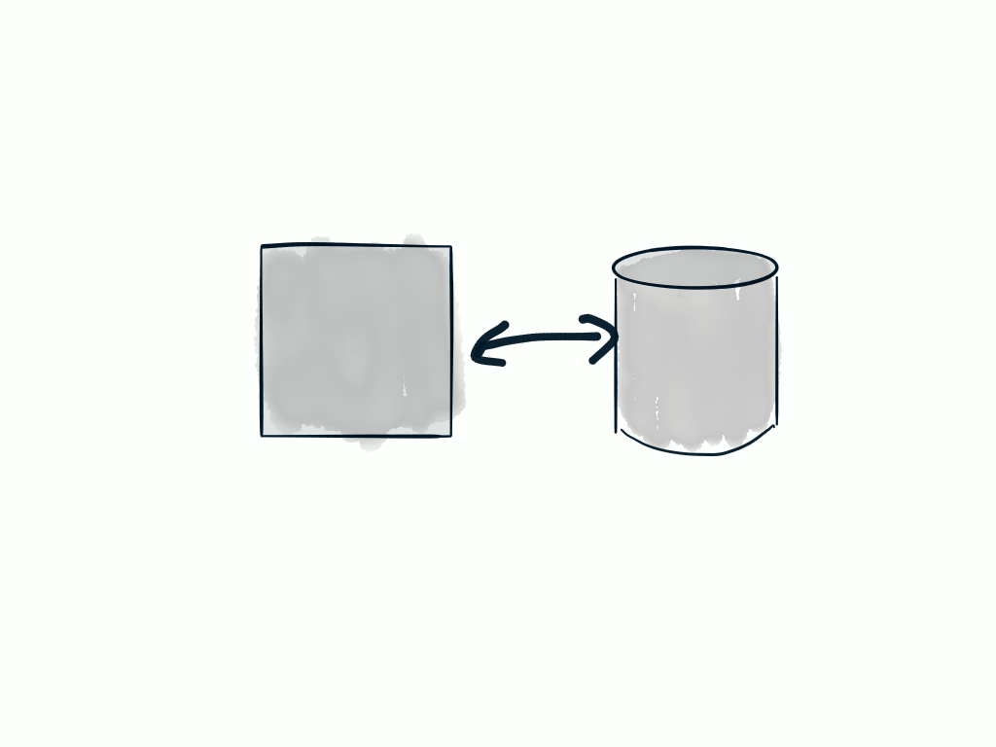
Runtime

Slide 15
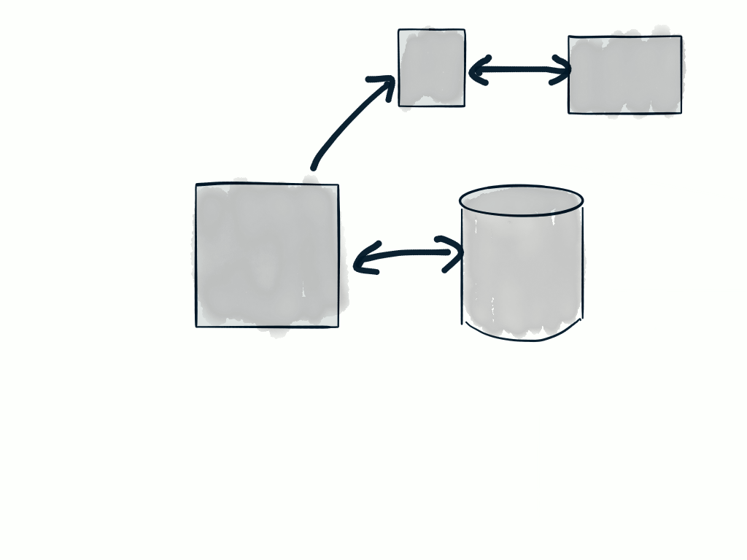

Workers
Runtime

Slide 16
$ psql
psql => \d
List of relations
schema | name | type | owner
--------+----------+-------+-----------
public | users | table | neovintage
public | accounts | table | neovintage
public | events | table | neovintage
public | tasks | table | neovintage
public | lists | table | neovintage

Slide 17
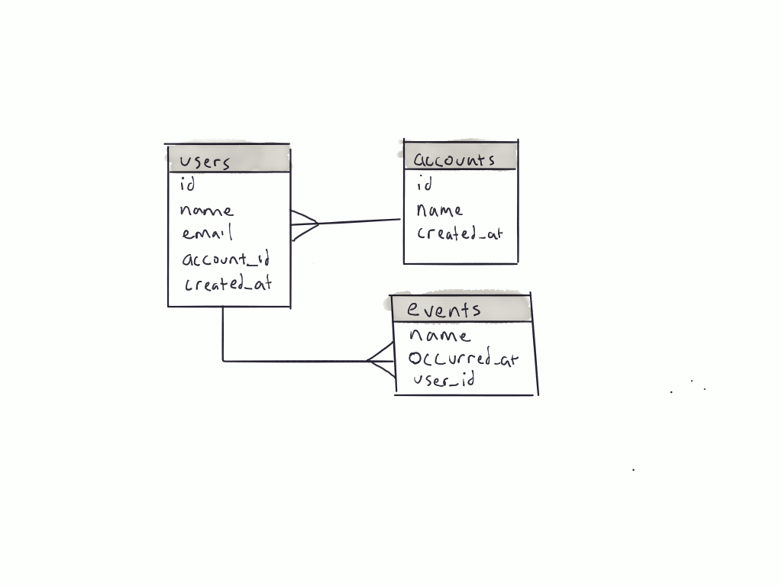

Slide 18


Slide 19


Slide 20

Ugh… Database Problems

Slide 21
$ psql
psql => \d
List of relations
schema | name | type | owner
--------+----------+-------+-----------
public | users | table | neovintage
public | accounts | table | neovintage
public | events | table | neovintage
public | tasks | table | neovintage
public | lists | table | neovintage

Slide 22
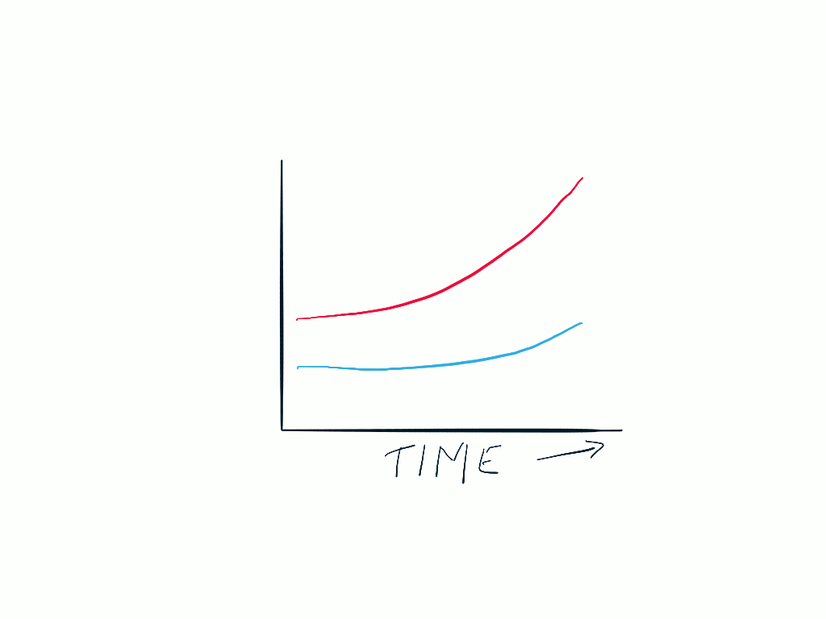
Events
Site Traffic
* Totally Not to Scale

Slide 23

One
Big Table
Problem

Slide 24
CREATE TABLE users (
id bigserial,
account_id bigint,
name text,
email text,
encrypted_password text,
created_at timestamptz,
updated_at timestamptz
);
CREATE TABLE accounts (
id bigserial,
name text,
owner_id bigint,
created_at timestamptz,
updated_at timestamptz
);

Slide 25
CREATE TABLE events (
user_id bigint,
account_id bigint,
session_id text,
occurred_at timestamptz,
category text,
action text,
label text,
attributes jsonb
);

Slide 26
Table
Partitioning

Slide 27

events

Slide 28
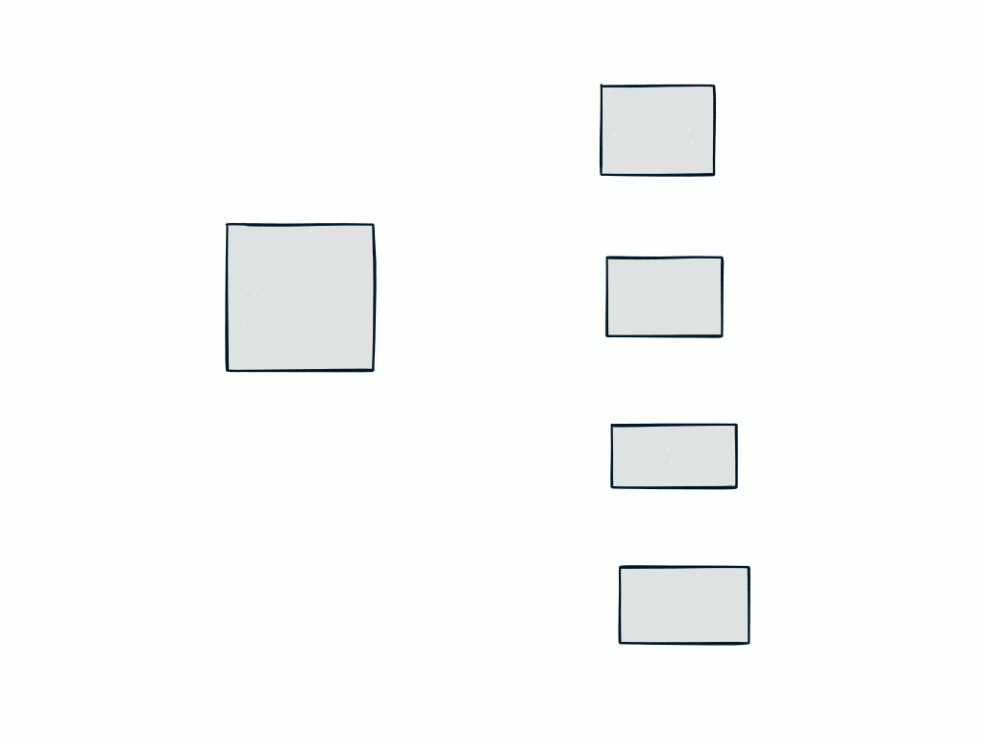
events_20160901
events
events_20160902
events_20160903
Add Some Triggers
events_20160904

Slide 29
$ psql
neovintage::DB=> \e
INSERT INTO events (
user_id,
account_id,
category,
action,
created_at)
VALUES (1,
2,
“in_app”, “purchase_upgrade”
“2016-09-07 11:00:00 -07:00”);

Slide 30
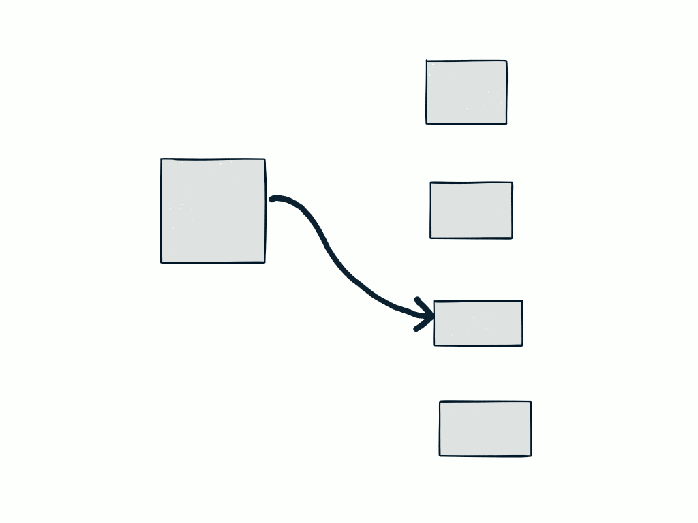
events_20160901
INSERT
query
events_20160902
events
events_20160903
events_20160904

Slide 31
Constraints
Data has little value after a period of time
Small range of data has to be queried
Old data can be archived or aggregated

Slide 32

There’s A Better Way

Slide 33
&&

Slide 34
One
Big Table
Problem

Slide 35
$ psql
psql => \d
List of relations
schema | name | type | owner
--------+----------+-------+-----------
public | users | table | neovintage
public | accounts | table | neovintage
public | events | table | neovintage
public | tasks | table | neovintage
public | lists | table | neovintage

Slide 36
Why Introduce Cassandra?
Linear Scalability
No Single Point of Failure
Flexible Data Model
Tunable Consistency

Slide 37
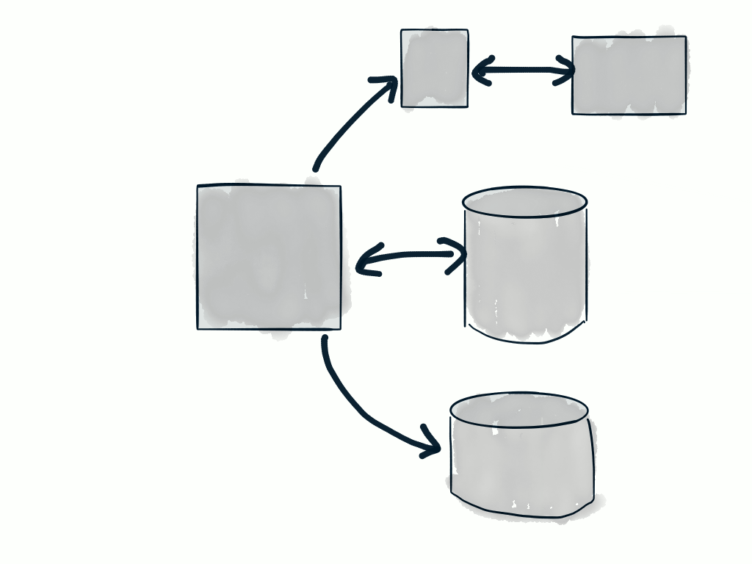
New Architecture
Workers
Runtime

Slide 38

I only know relational databases.
How do I do this?

Slide 39
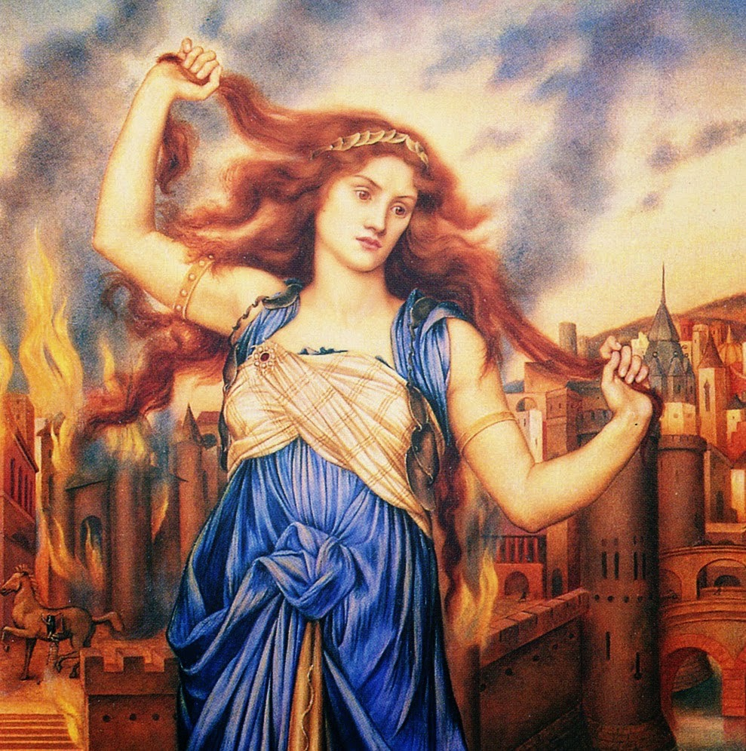
Understanding Cassandra

Slide 40

RELATIONAL
Two Dimensional
Table Spaces

Slide 41
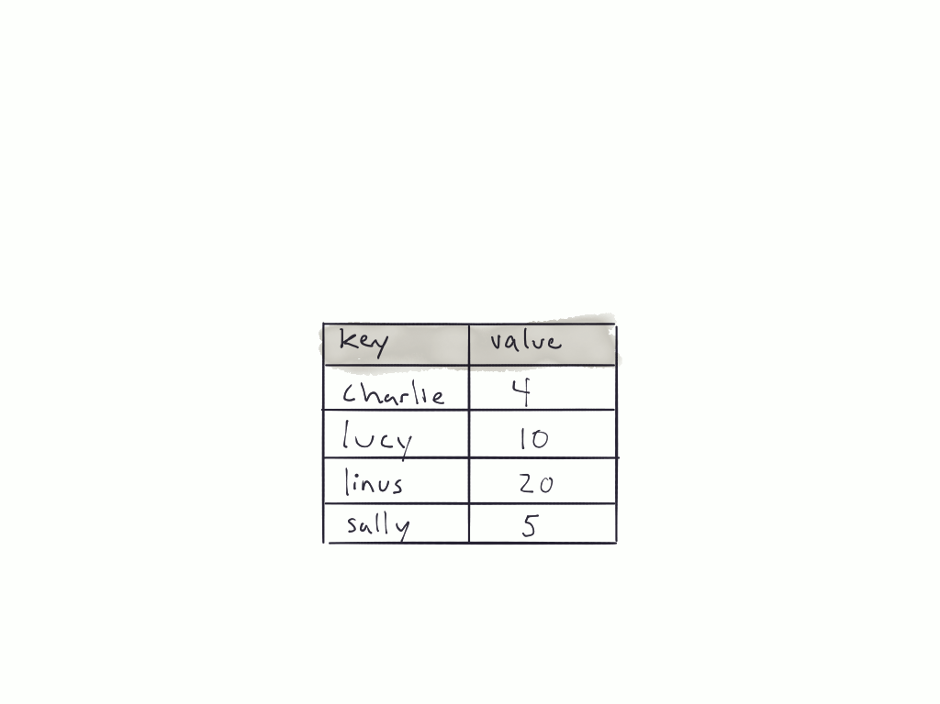
KEY-VALUE
Associative Arrays
or Hash

Slide 42
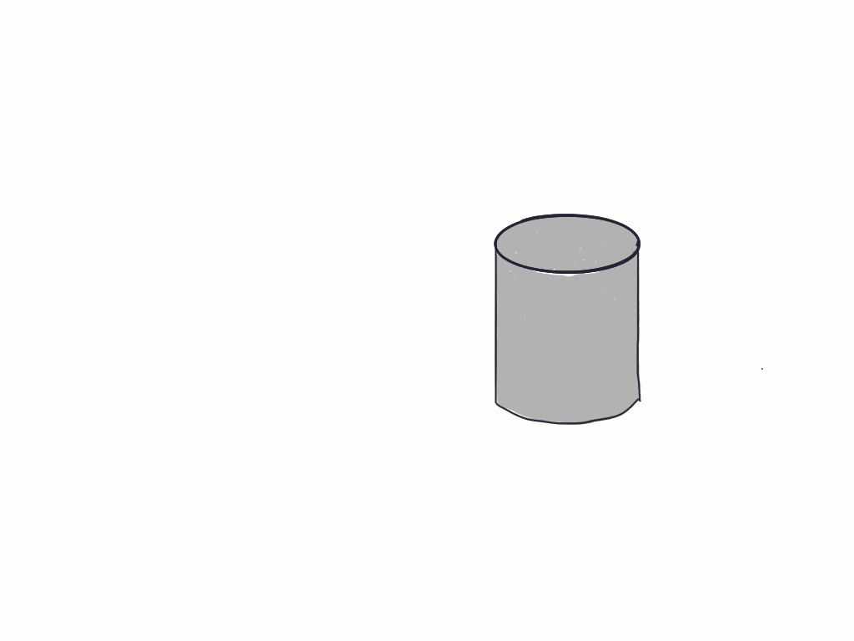
Postgres is Typically Run as Single Instance*

Slide 43
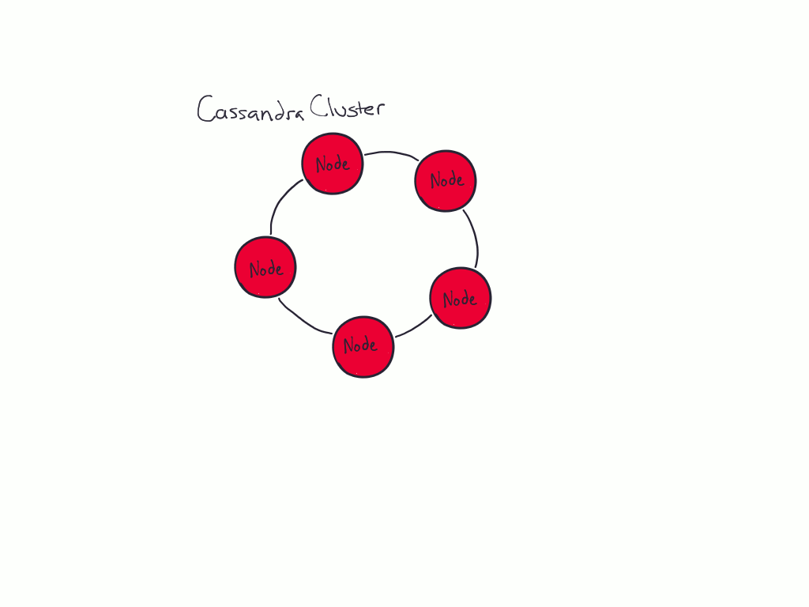
Partitioned Key-Value Store
Has a Grouping of Nodes (data center)
Data is distributed amongst the nodes

Slide 44
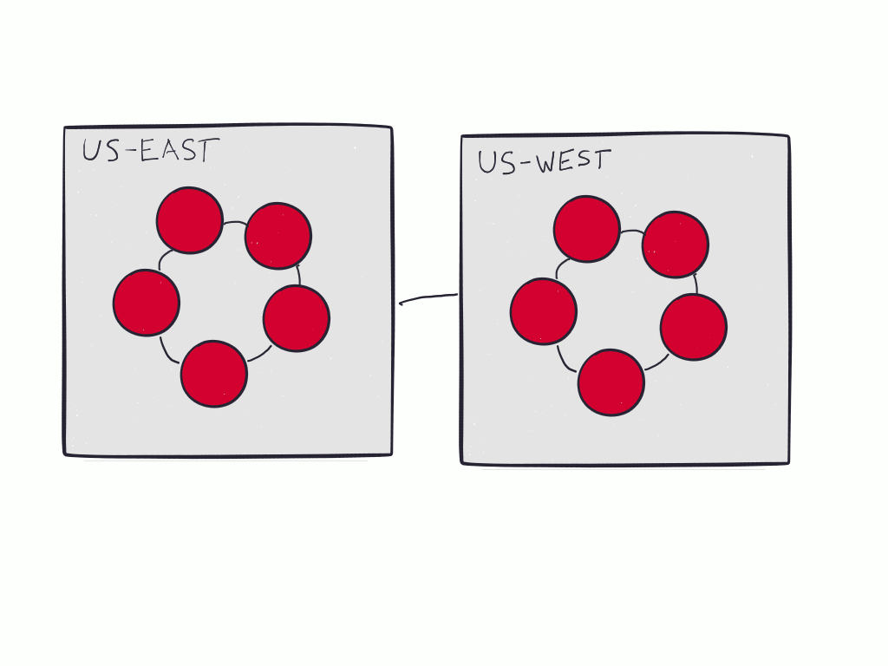
Cassandra Cluster with 2 Data Centers

Slide 45

Cassandra Query Language
SQL-like dialect

Slide 46

SQL-like
[sēkwel lahyk]
adjective
Resembling SQL in appearance, behavior or character
adverb
In the manner of SQL

Slide 47

Let’s Talk About Primary Keys
Partition

Slide 48
Table
Partitioning
Remember This?

Slide 49
Partition Key

Slide 50
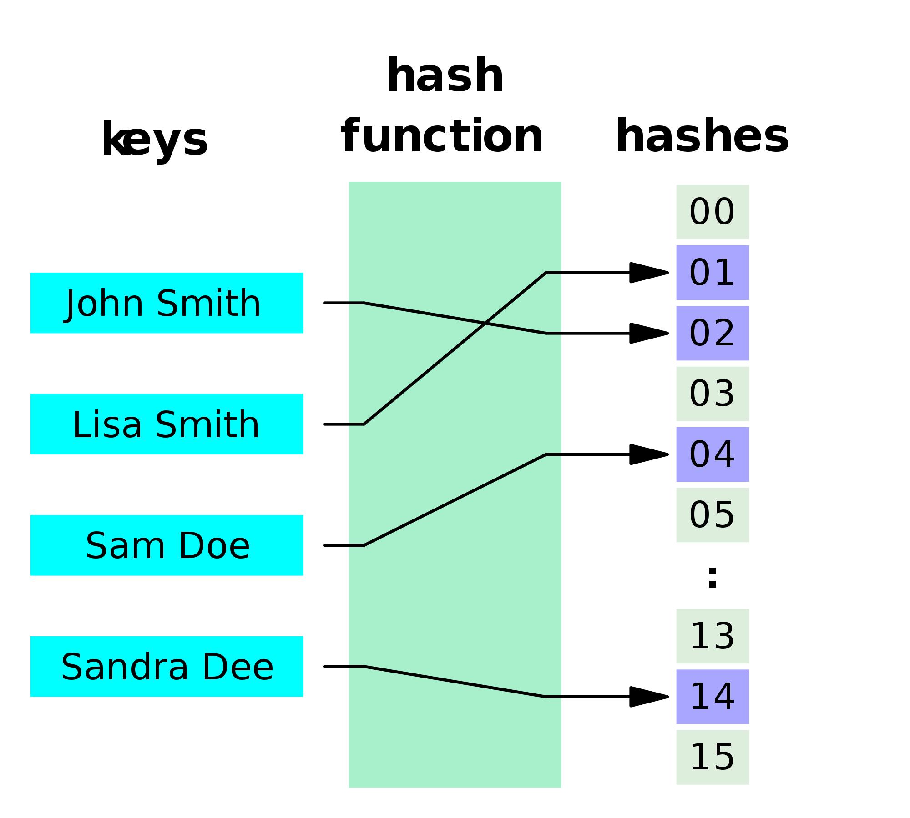

Slide 51
5 Node Cluster
Simplest terms: Data is partitioned amongst all the nodes using the hashing function.

Slide 52
Replication Factor

Slide 53
Replication Factor
Setting this parameter tells Cassandra how many nodes to copy incoming the data to
This is a replication factor of 3

Slide 54
But I thought Cassandra had tables?

Slide 55
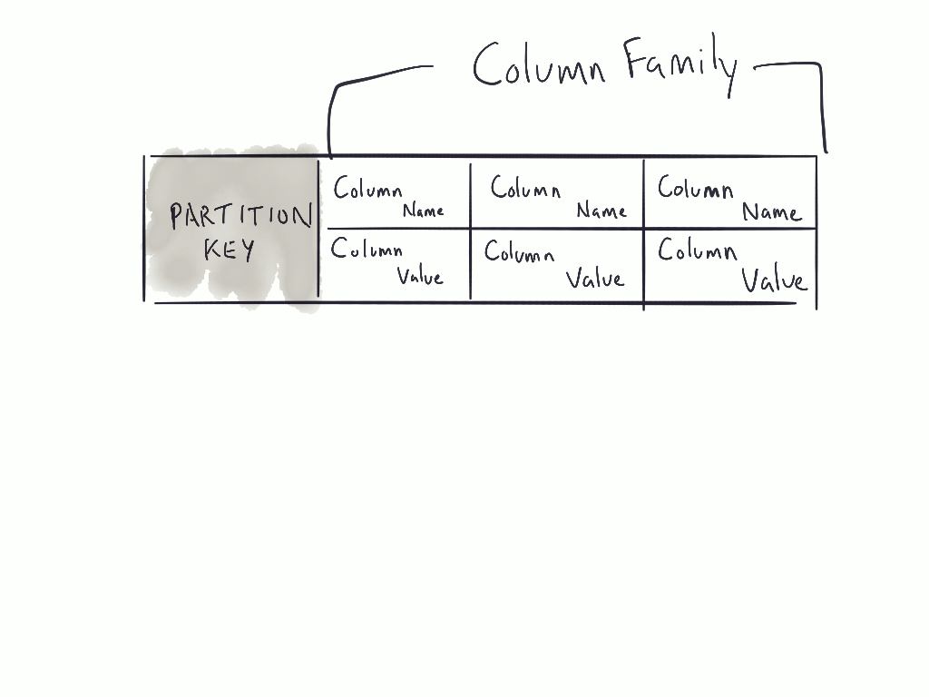
Prior to 3.0, tables were called column families

Slide 56
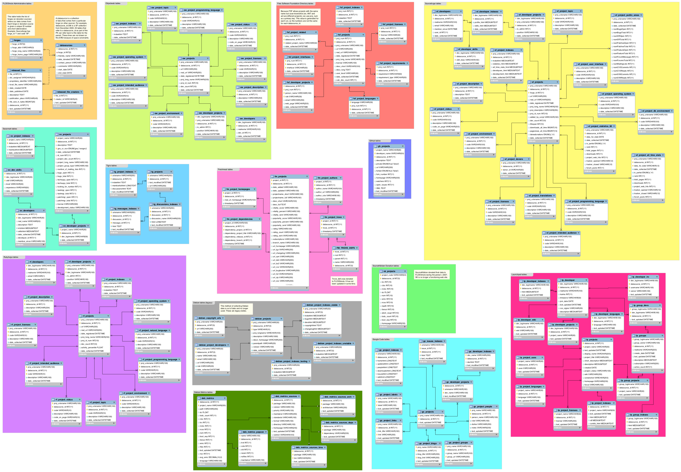
Let’s Model Our Events Table in Cassandra

Slide 57


Slide 58

We’re not going to go through any setup
Plenty of tutorials exist for that sort of thing
Let’s assume were working with 5 node cluster

Slide 59
$ psql
neovintage::DB=> \d events
Table “public.events"
Column | Type | Modifiers
---------------+--------------------------+-----------
user_id | bigint |
account_id | bigint |
session_id | text |
occurred_at | timestamp with time zone |
category | text |
action | text |
label | text |
attributes | jsonb |

Slide 60
$ cqlsh
cqlsh> CREATE KEYSPACE
IF NOT EXISTS neovintage_prod
WITH REPLICATION = {
‘class’: ‘NetworkTopologyStrategy’,
‘us-east’: 3
};

Slide 61
$ cqlsh
cqlsh> CREATE SCHEMA
IF NOT EXISTS neovintage_prod
WITH REPLICATION = {
‘class’: ‘NetworkTopologyStrategy’,
‘us-east’: 3
};

Slide 62
KEYSPACE == SCHEMA
CQL can use KEYSPACE and SCHEMA interchangeably
SCHEMA in Cassandra is somewhere between `CREATE DATABASE` and `CREATE SCHEMA` in Postgres

Slide 63
$ cqlsh
cqlsh> CREATE SCHEMA
IF NOT EXISTS neovintage_prod
WITH REPLICATION = {
‘class’: ‘NetworkTopologyStrategy’,
‘us-east’: 3
};
Replication Strategy

Slide 64
$ cqlsh
cqlsh> CREATE SCHEMA
IF NOT EXISTS neovintage_prod
WITH REPLICATION = {
‘class’: ‘NetworkTopologyStrategy’,
‘us-east’: 3
};
Replication Factor

Slide 65
Replication Strategies
NetworkTopologyStrategy - You have to define the network topology by defining the data centers. No magic here
SimpleStrategy - Has no idea of the topology and doesn’t care to. Data is replicated to adjacent nodes.

Slide 66
$ cqlsh
cqlsh> CREATE TABLE neovintage_prod.events (
user_id bigint primary key,
account_id bigint,
session_id text,
occurred_at timestamp,
category text,
action text,
label text,
attributes map<text, text>
);

Slide 67
Remember the Primary Key?
Postgres defines a PRIMARY KEY as a constraint that a column or group of columns can be used as a unique identifier for rows in the table.
CQL shares that same constraint but extends the definition even further. Although the main purpose is to order information in the cluster.
CQL includes partitioning and sort order of the data on disk (clustering).

Slide 68
$ cqlsh
cqlsh> CREATE TABLE neovintage_prod.events (
user_id bigint primary key,
account_id bigint,
session_id text,
occurred_at timestamp,
category text,
action text,
label text,
attributes map<text, text>
);

Slide 69
Single Column Primary Key
Used for both partitioning and clustering.
Syntactically, can be defined inline or as a separate line within the DDL statement.

Slide 70
$ cqlsh
cqlsh> CREATE TABLE neovintage_prod.events (
user_id bigint,
account_id bigint,
session_id text,
occurred_at timestamp,
category text,
action text,
label text,
attributes map<text, text>,
PRIMARY KEY (
(user_id, occurred_at),
account_id,
session_id
)
);

Slide 71
$ cqlsh
cqlsh> CREATE TABLE neovintage_prod.events (
user_id bigint,
account_id bigint,
session_id text,
occurred_at timestamp,
category text,
action text,
label text,
attributes map<text, text>,
PRIMARY KEY (
(user_id, occurred_at),
account_id,
session_id
)
);
Composite Partition Key

Slide 72
$ cqlsh
cqlsh> CREATE TABLE neovintage_prod.events (
user_id bigint,
account_id bigint,
session_id text,
occurred_at timestamp,
category text,
action text,
label text,
attributes map<text, text>,
PRIMARY KEY (
(user_id, occurred_at),
account_id,
session_id
)
);
Clustering Keys

Slide 73
PRIMARY KEY (
(user_id, occurred_at),
account_id,
session_id
)
Composite Partition Key
This means that both the user_id and the occurred_at columns are going to be used to partition data.
If you were to not include the inner parenthesis, the the first column listed in this PRIMARY KEY definition would be the sole partition key.

Slide 74
PRIMARY KEY (
(user_id, occurred_at),
account_id,
session_id
)
Clustering Columns
Defines how the data is sorted on disk. In this case, its by account_id and then session_id
It is possible to change the direction of the sort order

Slide 75
$ cqlsh
cqlsh> CREATE TABLE neovintage_prod.events (
user_id bigint,
account_id bigint,
session_id text,
occurred_at timestamp,
category text,
action text,
label text,
attributes map<text, text>,
PRIMARY KEY (
(user_id, occurred_at),
account_id,
session_id
)
) WITH CLUSTERING ORDER BY (
account_id desc, session_id acc
);
Ahhhhh… Just like SQL

Slide 76

Types
Data
Types

Slide 77
Postgres Type | Cassandra Type
bigint | bigint
int | int
decimal | decimal
float | float
text | text
varchar(n) | varchar
blob | blob
json | N/A
jsonb | N/A
hstore | map<type>, <type>

Slide 78
Postgres Type | Cassandra Type
bigint | bigint
int | int
decimal | decimal
float | float
text | text
varchar(n) | varchar
blob | blob
json | N/A
jsonb | N/A
hstore | map<type>, <type>

Slide 79
Challenges
JSON / JSONB columns don't have 1:1 mappings in Cassandra
You’ll need to nest MAP type in Cassandra or flatten out your JSON
Be careful about timestamps!! Time zones are already challenging in Postgres.
If you don’t specify a time zone in Cassandra the time zone of the coordinator node is used. Always specify one.

Slide 80

Ready for Webscale

Slide 81
General Tips
Just like Table Partitioning in Postgres, you need to think about how you’re going to query the data in Cassandra. This dictates how you set up your keys.
We just walked through the semantics on the database side. Tackling this change on the application-side is a whole extra topic.
This is just enough information to get you started.

Slide 82
BONUS
ROUND!

Slide 83
Workers
Runtime

Slide 84
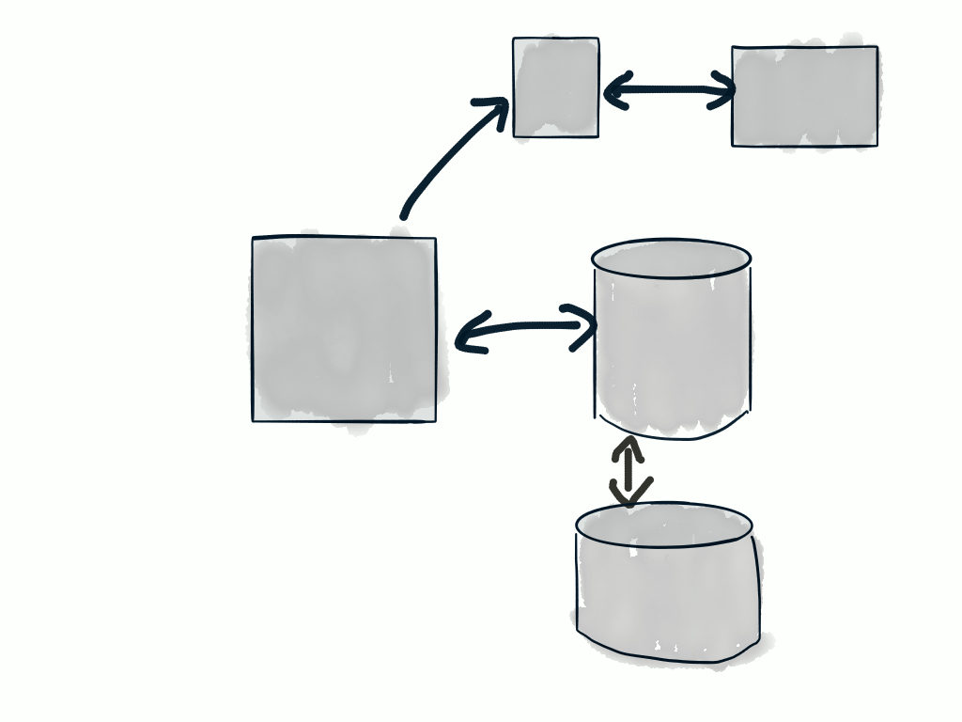
Workers
Runtime

Slide 85
fdw
=>
Foreign Data Wrapper

Slide 86
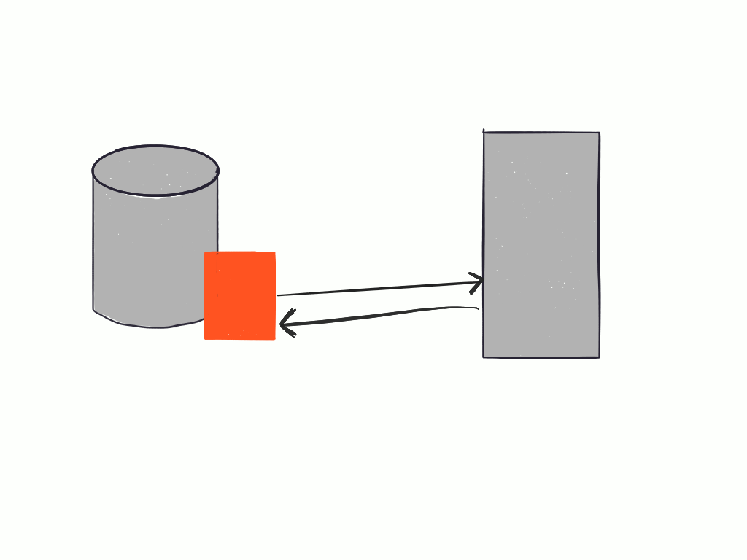
fdw

Slide 87
We’re not going to go through any setup, again……..
https://bitbucket.org/openscg/cassandra_fdw

Slide 88
$ psql
neovintage::DB=> CREATE EXTENSION cassandra_fdw;
CREATE EXTENSION

Slide 89
$ psql
neovintage::DB=> CREATE EXTENSION cassandra_fdw;
CREATE EXTENSION
neovintage::DB=> CREATE SERVER cass_serv
FOREIGN DATA WRAPPER cassandra_fdw
OPTIONS (host ‘127.0.0.1');
CREATE SERVER

Slide 90
$ psql
neovintage::DB=> CREATE EXTENSION cassandra_fdw;
CREATE EXTENSION
neovintage::DB=> CREATE SERVER cass_serv
FOREIGN DATA WRAPPER cassandra_fdw
OPTIONS (host ‘127.0.0.1');
CREATE SERVER
neovintage::DB=> CREATE USER MAPPING FOR public
SERVER cass_serv
OPTIONS (username 'test', password ‘test');
CREATE USER

Slide 91
$ psql
neovintage::DB=> CREATE EXTENSION cassandra_fdw;
CREATE EXTENSION
neovintage::DB=> CREATE SERVER cass_serv
FOREIGN DATA WRAPPER cassandra_fdw
OPTIONS (host ‘127.0.0.1');
CREATE SERVER
neovintage::DB=> CREATE USER MAPPING FOR public SERVER cass_serv
OPTIONS (username 'test', password ‘test');
CREATE USER
neovintage::DB=> CREATE FOREIGN TABLE cass.events (id int)
SERVER cass_serv
OPTIONS (schema_name ‘neovintage_prod',
table_name 'events', primary_key ‘id');
CREATE FOREIGN TABLE

Slide 92
neovintage::DB=> INSERT INTO cass.events (
user_id,
occurred_at,
label
)
VALUES (
1234,
“2016-09-08 11:00:00 -0700”,
“awesome”
);

Slide 93


Slide 94
Some Gotchas
No Composite Primary Key Support in cassandra_fdw
No support for UPSERT
Postgres 9.5+ and Cassandra 3.0+ Supported

Slide 95
¯\_(ツ)_/¯

